Slide 1


CZ2004 Human Computer Interaction Example Class 4-5
Hi-Fidelity of: Puah Yi Hao (B23 DSAI 2)
Reviewed By: Peh Wei Hang (B24)

Slide 2
Instructions for Hi-Fi
1) The Hi-Fi design has been inserted with an order of interactions. At each page, the number of actions (clicking on screen that will bring up a animation) is indicated. After all actions have been clicked a notification will pop up. E.g.
2) Blue text represent features that are interactive and can be clicked, while Black text represent descriptions of the feature, while Red text in slide 4 leads to an animation of the pinch feature.
3) There are some pages that are meant to represent examples of the features, but the user should return to the previous page after viewing them (E.g., Language page in Slide 17). Instructions asking the user to click are included in the form of the cancel button.
4) Audio Cues are included in the planning page and FAQ page hence do not be alarmed. They are meant as an example of the feature and to show case that the design gives Informative Feedback not just via display but audio feedback as well
5) The flow (if the order of animation is followed) should be: Main Page (First Time) -> Language/FAQ/Weather/Zoom -> Favourites -> Attraction clicking on map -> Main page -> Ride Filter -> Edit a plan -> Group -> Individual -> Main Page (Returning Users) -> Dining Filter
Note on copyright material: Unique shapes and images were used from https://www.fotor.com/ custom image library and icons were chosen from PowerPoint Icons. Audio Recording are from https://freesound.org/ or recorded by myself
Next slide will be a demo-slide of the instructions

Slide 3
Demonstration Slide
FEATURE 2
DEMO SLIDE
FEATURE 1
Click here to continue (2 action)
No more actions left
1. Feature 1 that you should view first
2. Feature 2 that you should view after Feature 1
Click here until the “No more actions left” appears
You’re good to go!

Slide 4







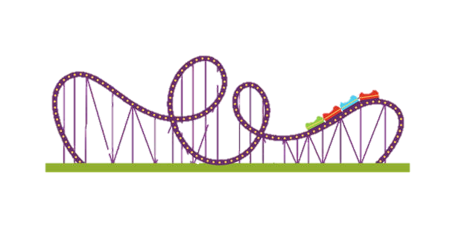





















1.1 Main Screen (First-time users)
Smart system will immediately display this screen to all first-time users
Language:
English
Welcome to Multiverse-Studio!
12:00pm
12/10/21
Weather Forecast
English
华文
22°C/89.6F
Rain
Francais
Now
…..
28°C/89.6F
Sunny
2. FAQ Questions
For users with queries
1:00pm
Click here to continue (8 action)
3. Weather Forecast
No more actions left
Name Wait/Travel Time
1. The Mummy 30/25
3.2. Close weather forecast pop-up
1. Language button
to toggle between
languages
2. Ferris Wheel 20/15
1.2. 华文 and French can be toggled
You look ^_^, consider riding The Overturn next
Add to favorites
View my favorites
5. Toggle display panel
between popular and favorite
6. Guide menu
compiling all interactions
Filter
Make my plan
My Plan
Rides
Shows
Dining
Services
Toilets
Others
7. Filter pane allows users to view attractions of certain types
8. Create/Edit a plan brings users to the planning page
4. Zoom in/out of the map or reset button
4.2 Animation of pinch feature (Click here)
Notes:
Main Interface (First-time users)
Icons Customer Service - https://www.iconpacks.net/free-icon/customer-service-1702.html
Credits:
Haunted House Icon: https://www.freepik.com/free-icon/haunted-house_15043211.htm
Background and Icons used from Powerpoint pre-defined icons and Paint3D

Slide 5


1.1 Main Screen (First-time users)
Smart system will immediately display this screen to all first-time users
Language:
English
Welcome to Multiverse-Studio!
12:00pm
12/10/21
Weather Forecast
English
华文
22°C/89.6F
Rain
Francais
Now
…..
28°C/89.6F
Sunny
1:00pm
No more actions left
2. More details about an attraction when selected
Click here to continue (3 action)
The Overturn
1.2 Show on map
(Click again to off)
You look ^_^, consider riding The Overturn next
Add to favorites
View popular attractions
3. Toggle display panel
back to popular attractions
1. Virtual character/
Recommender
Suggest attractions to
first time users to add
to favorites
Filter
Make my plan
My Plan
Rides
Shows
Dining
Services
Toilets
Others
Notes:
Favourites Page

Slide 6

1.2 Main Screen (Returning users)
Smart system will immediately display this screen to all returning users
Language:
English
Current location: Zone A
12:00pm
12/10/21
Weather Forecast
华文
22°C/89.6F
Rain
Francais
Now
…..
28°C/89.6F
Sunny
1:00pm
No more actions left
Click here to continue (3 action)
Name Wait/Travel Time
Circus live show 45/10 minutes
Burger Town 10/5 minutes
Haunted House 15/5 minutes
Path of the user's plan
Is displayed immediately
In an animation sequence
1. User's plan is displayed showing not just wait but travel time as well. Visited locations are also shown crossed out
Its lunch time, have a bite at Burger Town
Visited
Add to plan
Add to plan
Entrance 20 minutes ago
2. Smart system recommends (Add to Plan) based on
mood (Observe right side my plan when click add to plan)
Filter
Edit my plan
My Plan
Rides
Shows
Dining
Services
Toilets
Others
Return/Remove filter by clicking the same icon
3. Dining Filter (Includes Dietary filter)
Notes:
Main Interface (Returning users)
Icons Customer Service - https://www.iconpacks.net/free-icon/customer-service-1702.html
Credits:
Haunted House Icon: https://www.freepik.com/free-icon/haunted-house_15043211.htm
Background and Icons used from Powerpoint pre-defined icons and Paint3D

Slide 7
1.2 Main Screen (Returning users)
Smart system will immediately display this screen to all returning users
Language:
English
Current location: Zone A
12:00pm
12/10/21
Weather Forecast
华文
22°C/89.6F
Rain
Francais
Now
…..
28°C/89.6F
Sunny
1:00pm
No more actions left
Click here to continue (3 action)
Name Wait/Travel Time
Circus live show 45/10 minutes
Burger Town 10/5 minutes
Haunted House 15/5 minutes
Path of the user's plan
Is displayed immediately
In an animation sequence
1. User's plan is displayed showing not just wait but travel time as well. Visited locations are also shown crossed out
Its lunch time, have a bite at Burger Town
Visited
Add to plan
Add to plan
Entrance 20 minutes ago
2. Smart system recommends (Add to Plan) based on
mood (Observe right side my plan when click add to plan)
Filter
Edit my plan
My Plan
Rides
Shows
Dining
Services
Toilets
Others
3. Dining Filter (Includes Dietary filter)
Notes:
Main Interface (Returning users)
Icons Customer Service - https://www.iconpacks.net/free-icon/customer-service-1702.html
Credits:
Haunted House Icon: https://www.freepik.com/free-icon/haunted-house_15043211.htm
Background and Icons used from Powerpoint pre-defined icons and Paint3D

Slide 8


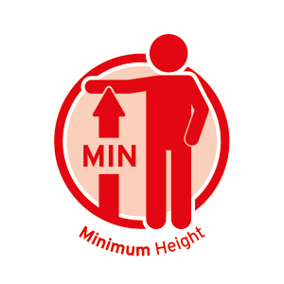





2. Interactive Map
Interaction on the screen interface with the map
Language:
English
Welcome to Multiverse-Studio!
12:00pm
12/10/21
Weather Forecast
Rides
Ride filter displayed
above all attractions
of type Rides
The Overturn
Wait time
min
Restrictions:
120
Name Wait Time
01:00PM – 09:30PM
1. The Mummy 30/25
Show on map
2. Ferris Wheel 20/15
Name of rides
can be selected for detailed information.
- close the tab
- show on map
Ferris Wheel
Wait time
min
Restrictions:
60
View my favorites
01:00PM – 09:30PM
Show on map
Filter
Make my plan
My Plan
Rides
Shows
Dining
Services
Toilets
Others
Return/Remove filter by clicking the same icon
Notes:
Filtered Rides

Slide 9

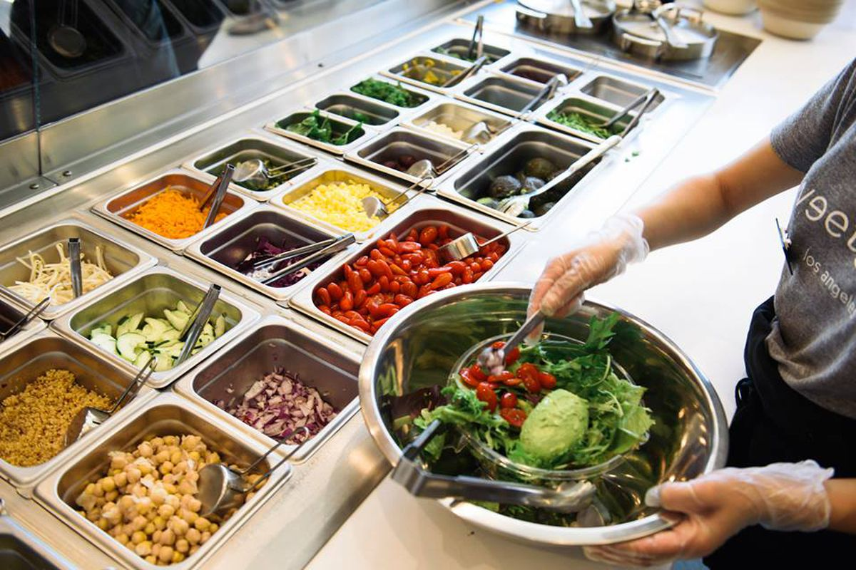

2. Interactive Map
Interaction on the screen interface with the map
Language:
English
Welcome to Multiverse-Studio!
12:00pm
12/10/21
Weather Forecast
Dining
3. Close and return
No more actions left
Click here to continue (3 action)
Hamburger Town
Wait time
min
Name Wait Time
01:00PM – 09:30PM
40
Show on map
1. The Mummy 30/25
2. Ferris Wheel 20/15
Pura Salad
Wait time
min
Restrictions:
60
View my favorites
01:00PM – 09:30PM
Show on map
2. Show on map
Vegan
Muslim
…..
Filter
Make my plan
My Plan
Rides
Shows
Dining
Services
Toilets
Others
Return/Remove filter by clicking the same icon
1. Filter by dietary requirement (Click on vegan arrow box)
Notes:
Filtered Dining

Slide 10
1.2 Main Screen (Returning users)
Smart system will immediately display this screen to all returning users
Language:
English
Current location: Zone A
12:00pm
12/10/21
Weather Forecast
华文
22°C/89.6F
Rain
Francais
Now
…..
28°C/89.6F
Sunny
1:00pm
No more actions left
Click here to continue (1 action)
Name Wait/Travel Time
Circus live show 45/10 minutes
Burger Town 10/5 minutes
Haunted House 15/5 minutes
Its lunch time, have a bite at Burger Town
Visited
Add to plan
Add to plan
Entrance 20 minutes ago
Filter
Edit my plan
My Plan
Rides
Shows
Dining
Services
Toilets
Others
1. Click to return
Notes:
Toilet Filter

Slide 11
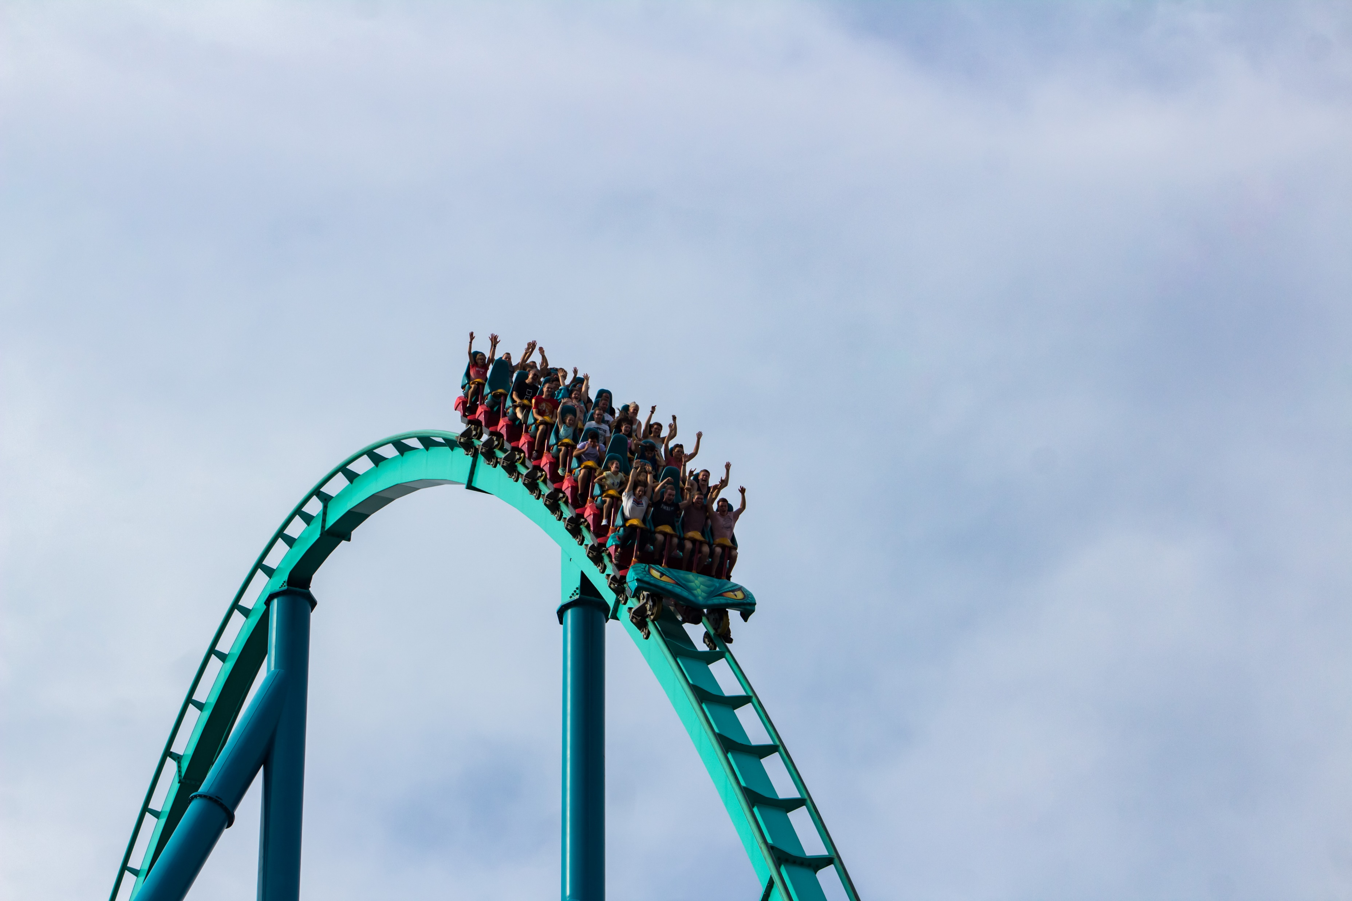



2. Interactive Map
Interaction on the screen interface with the map
Language:
English
Welcome to Multiverse-Studio!
12:00pm
12/10/21
Weather Forecast
Rides
Back
Coaster City
The Overturn
2. Return button
Click here to continue (2 action)
No more actions left
1. Toggle images of
attraction
Name Wait Time
01:00PM – 09:30PM
1. The Mummy 30/25
Add to Favorites
Added!
2. Ferris Wheel 20/15
Show on map
Attraction Details
Description
This attraction seats riders on a high-speed coaster climbing up to speeds of 120km/h with multiple loops and turns
Timings
Travel time: 10 min (From here)
Waiting time: 120 min
Activity duration: 3 min
View my favorites
Add to favorite after
Viewing more details
Restrictions:
- Riders must be at least 1.5m
- Pregnant people are not allowed to ride
Filter
Make my plan
My Plan
Rides
Shows
Dining
Services
Toilets
Others
Return/Remove filter by clicking the same icon
Notes:
Filtered Rides

Slide 12
2. Interactive Map
Interaction on the screen interface with the map
Language:
English
Welcome to Multiverse-Studio!
12:00pm
12/10/21
Weather Forecast
Rides
Wait time
min
The Overturn
120
Coaster City
The Overturn
Add to Favorites
Important information
Users can view the
wait time or directly
add to favorites
2. Close button
Click here to continue (2 action)
No more actions left
1. Toggle images of
attraction
Name Wait Time
01:00PM – 09:30PM
The Overturn
Add to Favorites
Show on map
Attraction Details
Description
This attraction seats riders on a high-speed coaster climbing up to speeds of 120km/h with multiple loops and turns
Timings
Travel time: 10 min (From here)
Waiting time: 120 min
Activity duration: 3 min
View my favorites
1. Full details about
the attraction including
restrictions, wait/travel/
activity time of attraction
Restrictions:
- Riders must be at least 1.5m
- Pregnant people are not allowed to ride
Filter
Make my plan
My Plan
Rides
Shows
Dining
Services
Toilets
Others
Notes:
Tapping on attraction

Slide 13
2. Interactive Map
Interaction on the screen interface with the map
Language:
English
Welcome to Multiverse-Studio!
12:00pm
12/10/21
Weather Forecast
Rides
Wait time
min
The Overturn
120
Coaster City
The Overturn
Add to Favorites
Important information
Users can view the
wait time or directly
add to favorites
2. Close button
Click here to continue (2 action)
No more actions left
1. Toggle images of
attraction
The Overturn
01:00PM – 09:30PM
Add to Favorites
Show on map
Attraction Details
Description
This attraction seats riders on a high-speed coaster climbing up to speeds of 120km/h with multiple loops and turns
Timings
Travel time: 10 min (From here)
Waiting time: 120 min
Activity duration: 3 min
View popular attractions
1. Full details about
the attraction including
restrictions, wait/travel/
activity time of attraction
Restrictions:
- Riders must be at least 1.5m
- Pregnant people are not allowed to ride
Filter
Make my plan
My Plan
Rides
Shows
Dining
Services
Toilets
Others
Notes:
Tapping on attraction (Favourites Page)

Slide 14
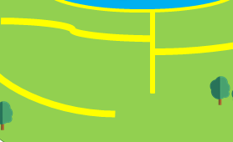




3.1 Zoom Feature (In)
Zooming into the map reveals more details in the area such as toilets
Language:
English
Welcome to Multiverse-Studio!
12:00pm
12/10/21
Weather Forecast
华文
22°C/89.6F
Rain
Francais
Now
…..
28°C/89.6F
Sunny
1:00pm
Name Wait Time
You look ^_^, consider riding The Mummy next
Add to favorites
View my favorites
Click zoom out/reset button to return
Filter
Make my plan
My Plan
Rides
Shows
Dining
Services
Toilets
Others
Notes:
Zoomed in page

Slide 15
3.1 Zoom Feature (Out)
Zooming out of the map might give some users a wider picture of the place
Language:
English
Welcome to Multiverse-Studio!
12:00pm
12/10/21
Weather Forecast
华文
22°C/89.6F
Rain
Francais
Now
…..
28°C/89.6F
Sunny
1:00pm
Name Wait Time
You look ^_^, consider riding The Mummy next
Add to favorites
View my favorites
Click zoom out/reset button to return
Filter
Make my plan
My Plan
Rides
Shows
Dining
Services
Toilets
Others
Notes:
Zoomed out page

Slide 16

1.1 Main Screen (First-time users)
Smart system will immediately display this screen to all first-time users
Language:
English
Welcome to Multiverse-Studio!
12:00pm
12/10/21
Weather Forecast
English
华文
22°C/89.6F
Rain
Francais
Now
…..
28°C/89.6F
Sunny
1:00pm
Name Wait/Travel Time
1. The Mummy 30/25
2. Ferris Wheel 20/15
You look ^_^, consider riding The Overturn next
Add to favorites
View my favorites
Filter
Make my plan
My Plan
Rides
Shows
Dining
Services
Toilets
Others
Click here to return
Pinch to zoom in or out alternatively
Notes:
Main Interface (First-time users) PINCH AND ZOOM
Icons Customer Service - https://www.iconpacks.net/free-icon/customer-service-1702.html
Credits:
Haunted House Icon: https://www.freepik.com/free-icon/haunted-house_15043211.htm
Background and Icons used from Powerpoint pre-defined icons and Paint3D

Slide 17

4. Guide Menu
Guide menu holds all the possible interactions with the kiosk. Compilation of the uses of the system. Includes a Night/Light mode to cater to different users
Language:
English
Welcome to Multiverse-Studio!
12:00pm
12/10/21
Weather Forecast
22°C/89.6F
Rain
Now
28°C/89.6F
Sunny
1:00pm
Make a plan
Frequently Asked Questions
Name Wait Time
Rides
Shows
Guide menu is a compile
of all features in the system. Hovering mouse
will outline where the user is for better feedback
- toggle reading mode to light mode
- close guide menu
Try moving cursor over
guide menu and toggling
the mode, close after done
Dining
View my favorites
What's popular
Filter
Others
Make my plan
My Plan
Rides
Shows
Dining
Services
Toilets
Others
Notes:
Dark Mode

Slide 18
4. Guide Menu
Guide menu holds all the possible interactions with the kiosk. Compilation of the uses of the system. Includes a Night/Light mode to cater to different users
Language:
English
Welcome to Multiverse-Studio!
12:00pm
12/10/21
Weather Forecast
22°C/89.6F
Rain
Now
28°C/89.6F
Sunny
1:00pm
Make a plan
Frequently Asked Questions
Name Wait Time
Rides
Shows
Guide menu is a compile
of all features in the system. Hovering mouse
will outline where the user is for better feedback
- toggle reading mode to night mode
- close guide menu
Try moving cursor over
guide menu and toggling
the mode, close after done
Dining
View my favorites
What's popular
Filter
Others
Make my plan
My Plan
Rides
Shows
Dining
Services
Toilets
Others
Notes:
Light Mode

Slide 19







5. FAQ
Help/FAQ page can address users' queries providing support to them
Language:
English
Welcome to Multiverse-Studio!
12:00pm
12/10/21
Weather Forecast
华文
22°C/89.6F
Rain
Back to
map
Francais
Now
…..
FAQ
Cancel
28°C/89.6F
Sunny
3. Return to map
1:00pm
No more actions left
Click here to continue (3 action)
Type something here…
2. Audio Feature
will accept audio
to text and searches
Warning: Audio plays
Tell me about multiverse studio …
2.2 Search specific
query
General
General
What is Multiversal Studios?
Multiversal Studios is a fantasy theme park as part of HCI CZ2004
What is Multiversal Studios?
- Multiversal Studios is a fantasy theme park as part of HCI CZ2004
What am I reading?
- You are reading the general queries page for the Hi-Fidelity
How do I use this interface?
- ……
Advanced
1.2 Close drop-down menu
by clicking the same place
Rides
1. Drop-down menu
to all FAQ under
certain categories
by clicking down
arrow
Policy
….
Contact Us
12345678 CZ2004@.e.ntu.edu.sg Help Desk
Notes:
FAQ / Help Page

Slide 20

5. Language
International users can toggle between languages
12:00pm
12/10/21
u
语言：
华文
欢迎来到 Multiverse-Studio!
天气预报
English
22°C/89.6F
下雨
Francais
Now
…..
28°C/89.6F
阳光
1:00pm
Return to English language
For the rest of the Hi-Fi
名字 等待时间
你看起来很开心，试一下 The Mummy
加进计划
查看我的最爱
筛选
我的计划
计划
游乐设施
显示
用餐
服务
厕所
其他
Notes:
Language Feature (Chinese)

Slide 21
5. Language
International users can toggle between languages
12:00pm
12/10/21
u
Langue:
Francais
Bievenue à Multiverse-Studio!
Temps
English
22°C/89.6F
Rain
华文
Now
…..
28°C/89.6F
Sunny
1:00pm
Return to English language
For the rest of the Hi-Fi
Nom Temps
Tu as l'air heureux The Mummy
ajouter au plan
Favoruite
Filtre
Mon Plan
Plan
Monte
Spectacles
Manger
Service
Toilettes
Autre
Notes:
Language Feature (France)

Slide 22


6.1 Planning page
4-Step process to allow users to make a plan of their choice/ recommendation
Language:
English
Make a plan
12:00pm
12/10/21
Weather Forecast
华文
22°C/89.6F
Rain
Make a plan
Francais
Now
…..
28°C/89.6F
Sunny
Choose your plan type:
1:00pm
Back to map
Click here to continue (1 action)
No more actions left
Indicates to user
which step they are
at
Individual
Group
2. Return to map
provides reversal
of actions
Users detected: 1
1. Group
Plan (Recommended
to select this order)
1.2 Individual
plan
Indicate the number of users present in front of the system currently
Notes:
Make/Edit Plan Page 1

Slide 23




6.2.1 Planning page
4-Step process to allow users to make a plan of their choice/ recommendation
Language:
English
Make a plan
12:00pm
12/10/21
Weather Forecast
Make a plan
华文
22°C/89.6F
Rain
> Group
Now
Francais
Group
Choose a plan:
…..
28°C/89.6F
Sunny
1:00pm
Back to map
Group 1
Click here to continue (3 actions)
No more actions left
Switch to Individual
Make your own
Create your own plan
beginning with a stuff
from your favourites
Horror
Try out our custom plan
of mostly scary themed
attractions
Under 16?
Specially catered to
young children with live
shows and safe rides
Add group
Group 2
3. Switch to individual
planning without having to go back to change
Select
Select
Select
1. Split group
group into subgroups for users who want to plan as separate groups
Exciting
More types of rides we
have available
Mixed
Try all kinds of rides
Random
Just random …
2. Choose plan type
Users can select the starting map plan they would like with the select button
(only “Make you own” is animated)
Select
Select
Select
Wide selection of plan types for users to choose from. Users who are new can choose from a pre-defined plan type or can build from scratch
Notes:
Make/Edit Plan Page 2 (Group)

Slide 24
6.2.2 Planning page
4-Step process to allow users to make a plan of their choice/ recommendation
Language:
English
Make a plan
12:00pm
12/10/21
Weather Forecast
Make a plan
华文
22°C/89.6F
Rain
> Individual
Now
Francais
Individual
Choose a plan:
…..
28°C/89.6F
Sunny
1:00pm
Back to map
Click here to continue (1 actions)
No more actions left
Switch to Group
Make your own
Create your own plan
beginning with a stuff
from your favourites
Horror
Try out our custom plan
of mostly scary themed
attractions
Under 16?
Specially catered to
young children with live
shows and safe rides
1. Switch to group
Planning for users
who change their mind
Select
Select
Select
Exciting
More types of rides we
have available
Mixed
Try all kinds of rides
Random
Just random …
2. Choose plan type
Users can select the starting map plan they would like with the select button
(only “Make you own” is animated)
Select
Select
Select
Notes:
Make/Edit Plan Page 2 (Individual)

Slide 25





6.3.2 Planning page
4-Step process to allow users to make a plan of their choice/ recommendation
Language:
English
Make a plan
12:00pm
12/10/21
Weather Forecast
Make a plan
华文
22°C/89.6F
Rain
> Individual
> Make your own
Now
Francais
…..
28°C/89.6F
Sunny
Back to plan type
1:00pm
Recommendation
Select the circus icon
Select the haunted house icon
Press on Haunted House
Press
Click show on map
6.1) Submit plan
6.2) Split Group
Current plan
Time Name
1000 Circus live show
1130 Haunted House
2. Editing plan
- remove from plan
- show on map
- undo action
- submit plan
Undo
Submit
Type to search for attraction here…
1. Select Icons
Users can add an
attraction to the plan by tapping on it or searching it up
3. Search bar for users who want to search attractions (animation plays)
Split groups
4. Switch to plan as group
No more actions left
Click here to continue (4 actions)
Notes:
Make/Edit Plan Page 3 (Individual)

Slide 26

6.3.2 Planning page
4-Step process to allow users to make a plan of their choice/ recommendation
Language:
English
Make a plan
12:00pm
12/10/21
Weather Forecast
Make a plan
华文
> Individual
> Make your own
Francais
…..
Back to plan type
Current plan
Time Name
0930 Ferris Wheel
Ferris Wheel [+]
Ferry Ride [+]
………..
The Overturn [!]
Undo
Submit
Type to search for attraction here…
Ferr
Split groups
Click here to return
Notes:
ANIMATION of Search Bar

Slide 27




6.3.1 Planning page
4-Step process to allow users to make a plan of their choice/ recommendation
Language:
English
Make a plan
12:00pm
12/10/21
Weather Forecast
Make a plan
> Group
> Make your own
Back to plan type
Current plan
Current plan
Current plan
Current plan
Current plan
Current plan
Recommendation
Select the circus icon
Select the haunted house icon
Press on submit for both sides
Select compare plans
Select view on map
Current plan
Time Name
Time Name
1000 Circus live show
1130 Haunted House
Please confirm:
Please confirm:
Plan saved
Successfully!
Plan saved
Successfully!
Editing plan
- remove from plan
- show on map
- undo action
- submit plan
(click on the submit word if arrow lagging)
Scan your plan
Scan your plan
Click here to continue (1 actions)
Undo
Submit
Undo
Submit
No more actions left
View on map
View on map
Type to search for attraction here…
Type to search for attraction here…
Merge group
Compare plans
View plan on
map
1. Switch to plan as Individual/Single Group
1. 2 Compare plans of 2 groups
Notes:
Make/Edit Plan Page 3 and 4(Group, Plan and Save)

Slide 28
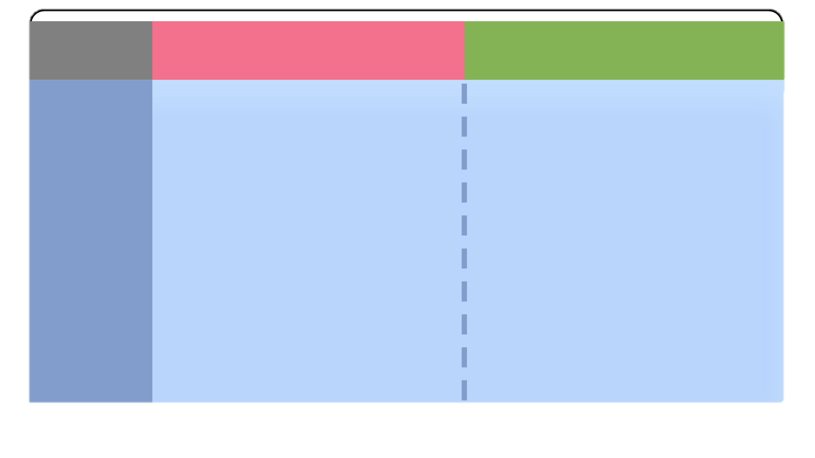
6.3.1 Planning page
4-Step process to allow users to make a plan of their choice/ recommendation
Language:
English
Make a plan
12:00pm
12/10/21
Weather Forecast
Make a plan
> Group
> Make your own
Back to plan type
Current plan
Current plan
Current plan
Current plan
Time Plan 1 Plan 2
Close the comparison
Time Name
Time Name
1000 Circus live show
1130 Haunted House
9AM
10AM
11AM
12PM
1PM
2PM
Haunted House
Plan saved
Successfully!
Circus live show
Plan saved
Successfully!
Merry Go Round
Scan your plan
Scan your plan
Undo
Submit
Undo
Submit
View on map
View on map
Type to search for attraction here…
Type to search for attraction here…
Merge group
Notes:
Make/Edit Plan Page 3 and 4(Group, Plan and Save)

Slide 29
6.3.2 Planning page
4-Step process to allow users to make a plan of their choice/ recommendation
Language:
English
Make a plan
12:00pm
12/10/21
Weather Forecast
Make a plan
> Individual
> Make your own
Back to plan type
No more actions left
Current plan
Click here to continue (1 actions)
1. Confirmation feature added (Not in Lo-Fi previously)
Please confirm:
Confirm Decision
(Audio plays)
Notes:
Make/Edit Plan Page 4 (Individual, Confirmation)

Slide 30
6.3.2 Planning page
4-Step process to allow users to make a plan of their choice/ recommendation
Language:
English
Make a plan
12:00pm
12/10/21
Weather Forecast
Make a plan
> Individual
> Make your own
Back to plan type
Current plan
Plan saved
Successfully!
Scan your plan
View on map
View plan on
map
Notes:
Make/Edit Plan Page 4 (Individual, Saving Successfully)

Slide 31
7. Exit
This is the end of the Hi-Fi page (Not part of
the design but to indicate to marker he is
at the last slide)
Language:
English
Welcome to Multiverse-Studio!
12:00pm
12/10/21
Weather Forecast
Thank you
HOPE YOU ENJOYED THE HI-FI, HAVE A NICE DAY
Notes:
THE END

